Slide 1
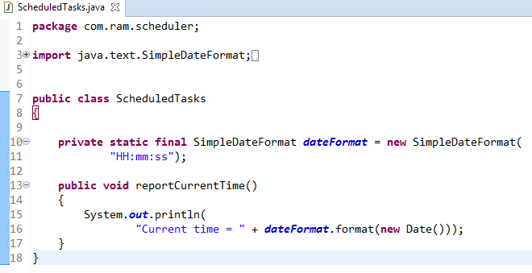
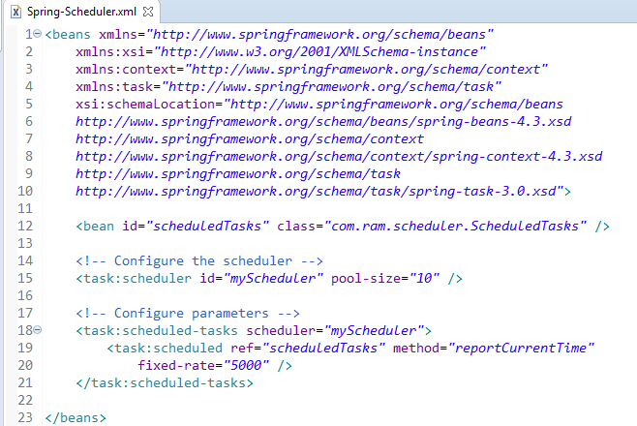
Schedule a Task at a Fixed Rate [Configuring scheduled tasks using XML]
NOTE: This example uses fixedRate, which specifies the interval between method invocations measured from the start time of each invocation.
Note that the beginning of the task execution doesn’t wait for the completion of the previous execution.This option should be used when each execution of the task is independent.

Slide 2
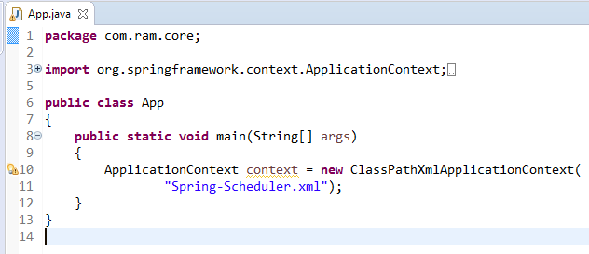
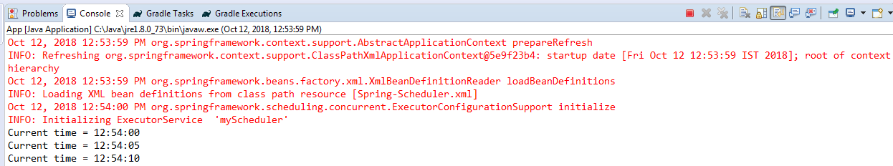
Schedule a Task at a Fixed Rate [Configuring scheduled tasks using XML]

